Slide 1
Virtual Fixtures
Obstacle Avoidance
Trajectory Guidance
Surface Guidance
Insertion Guidance

Slide 2
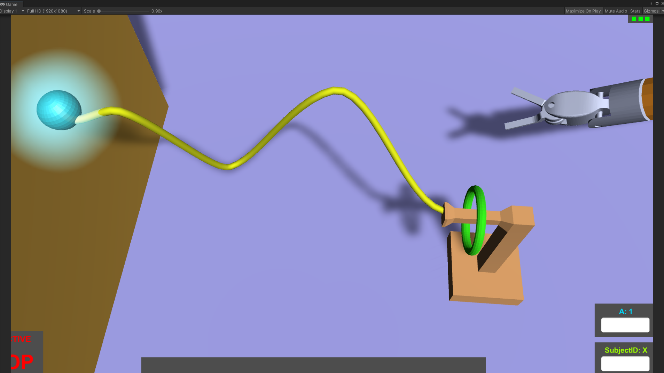
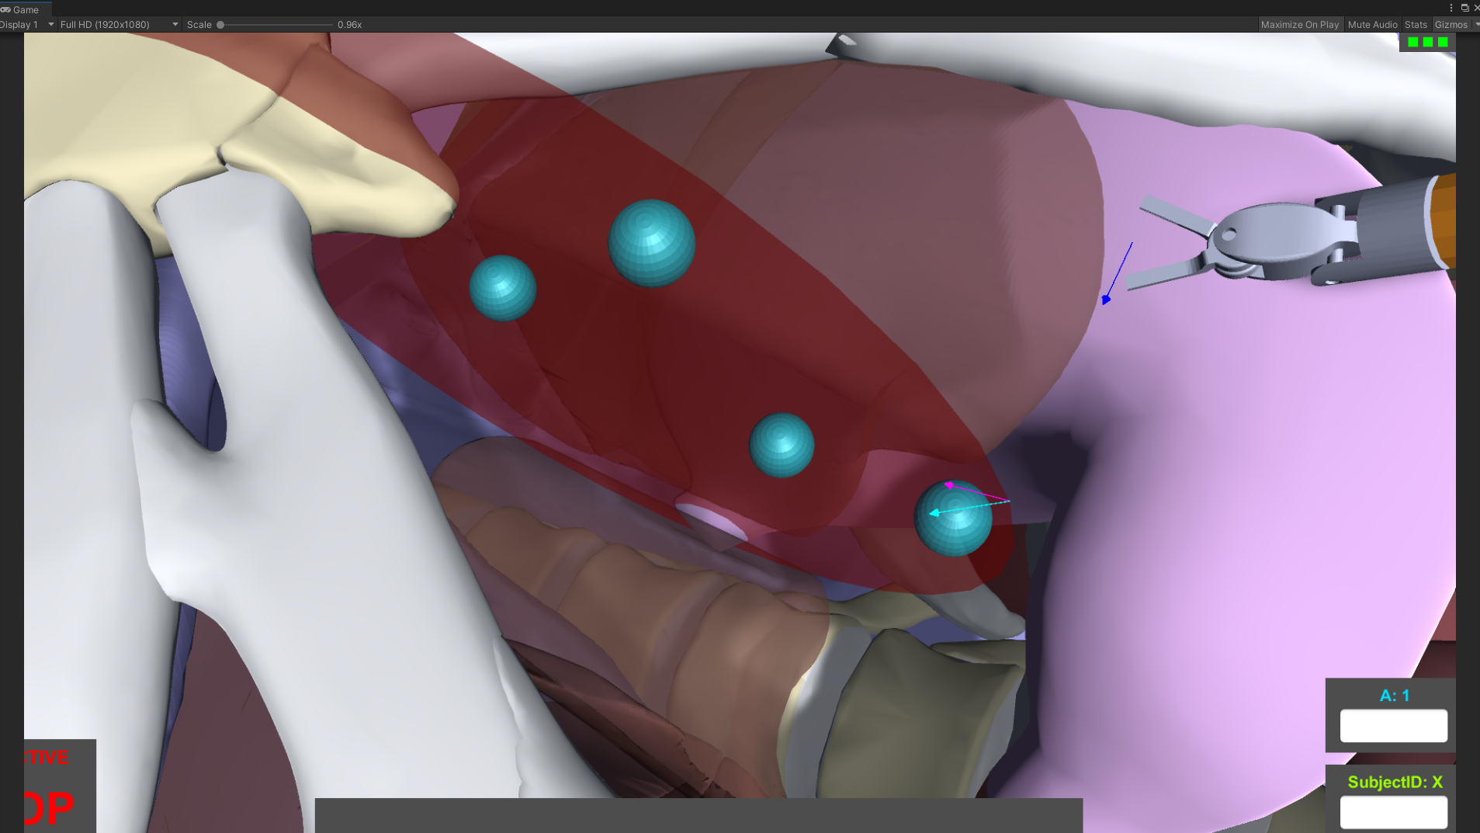
Wrist articulation
Virtual fixture
Trajectory GUIDANCE
Surface GUIDANCE
Evaluation metrics
Distance and angle to reference trajectory/surface
Time of execution
Clutch time

Slide 3
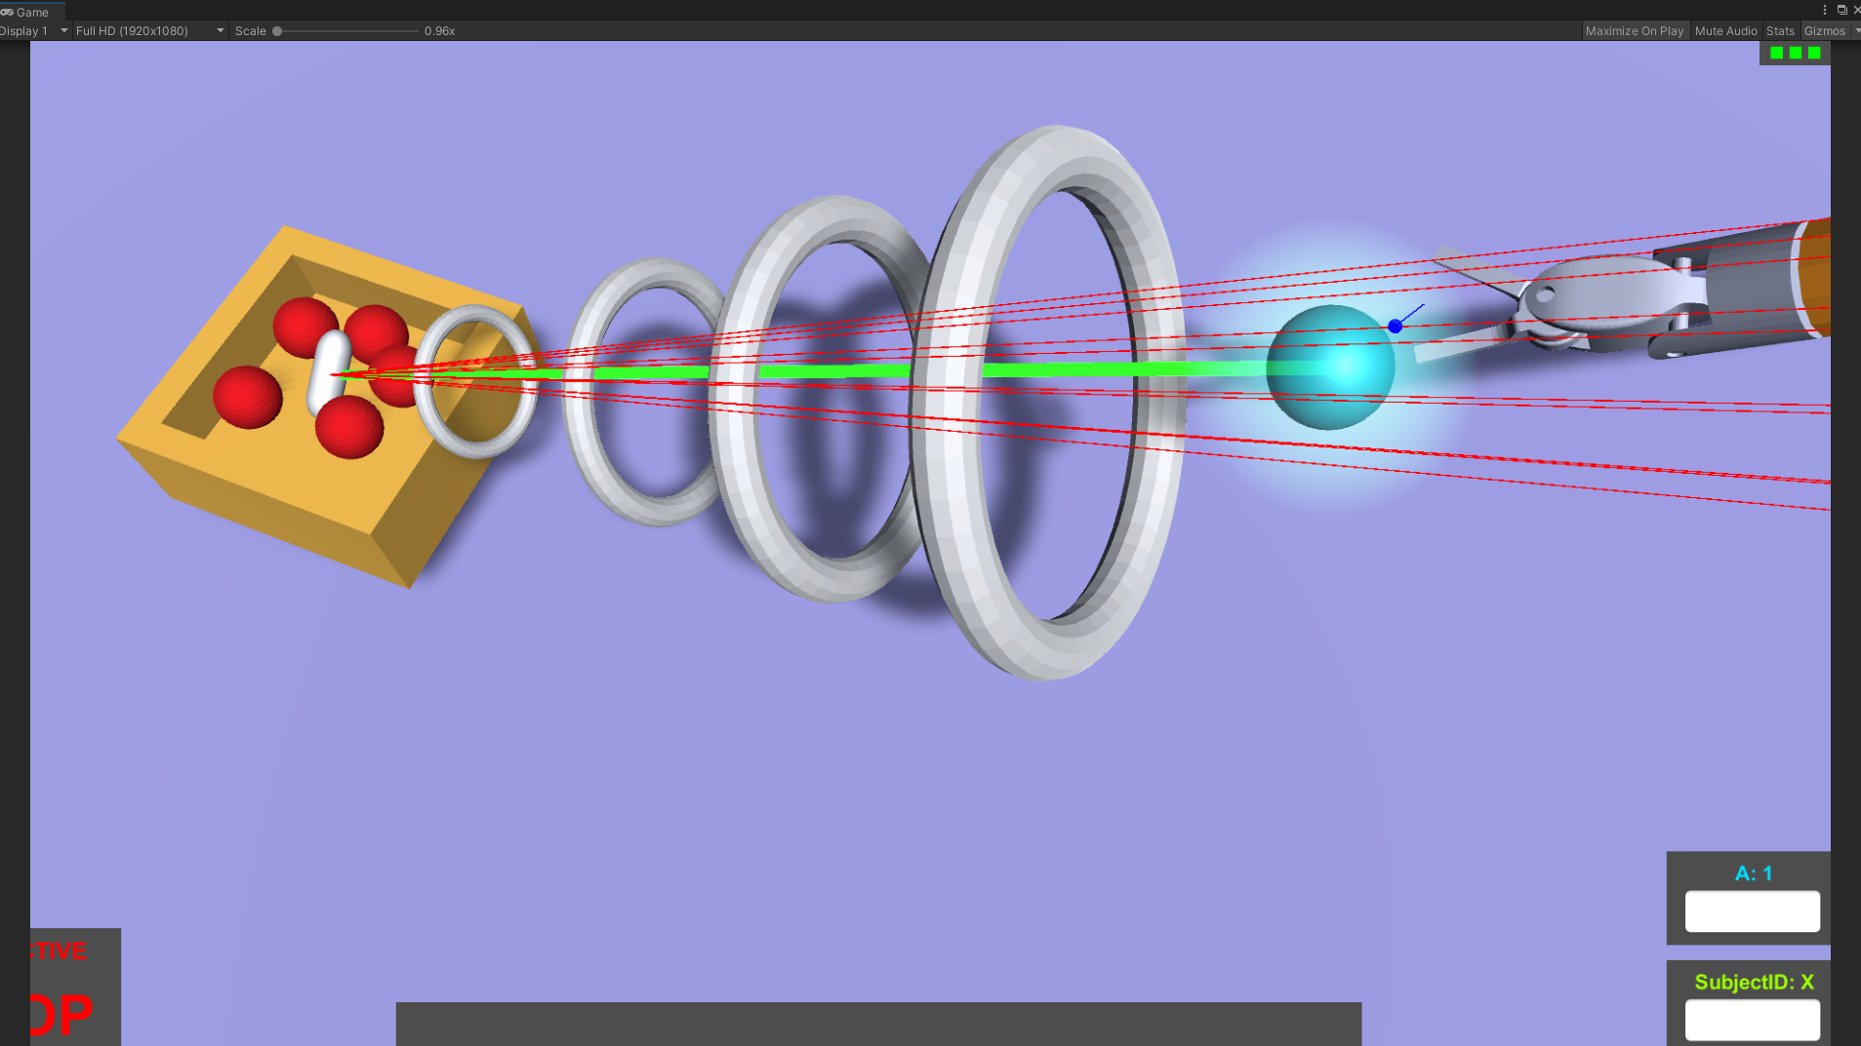
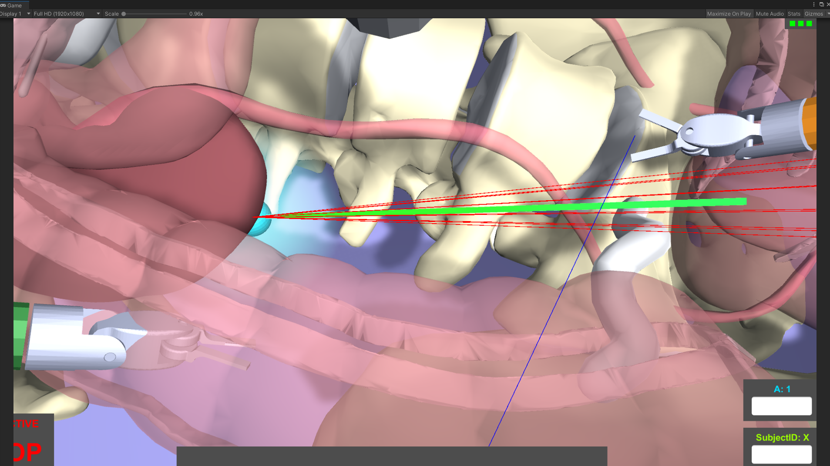
Depth perception
Virtual Fixture:
Insertion GUIDANCE
Evaluation metrics
Distance error from trajectory
Distance from camera
Time of execution
Clutch time

Slide 4
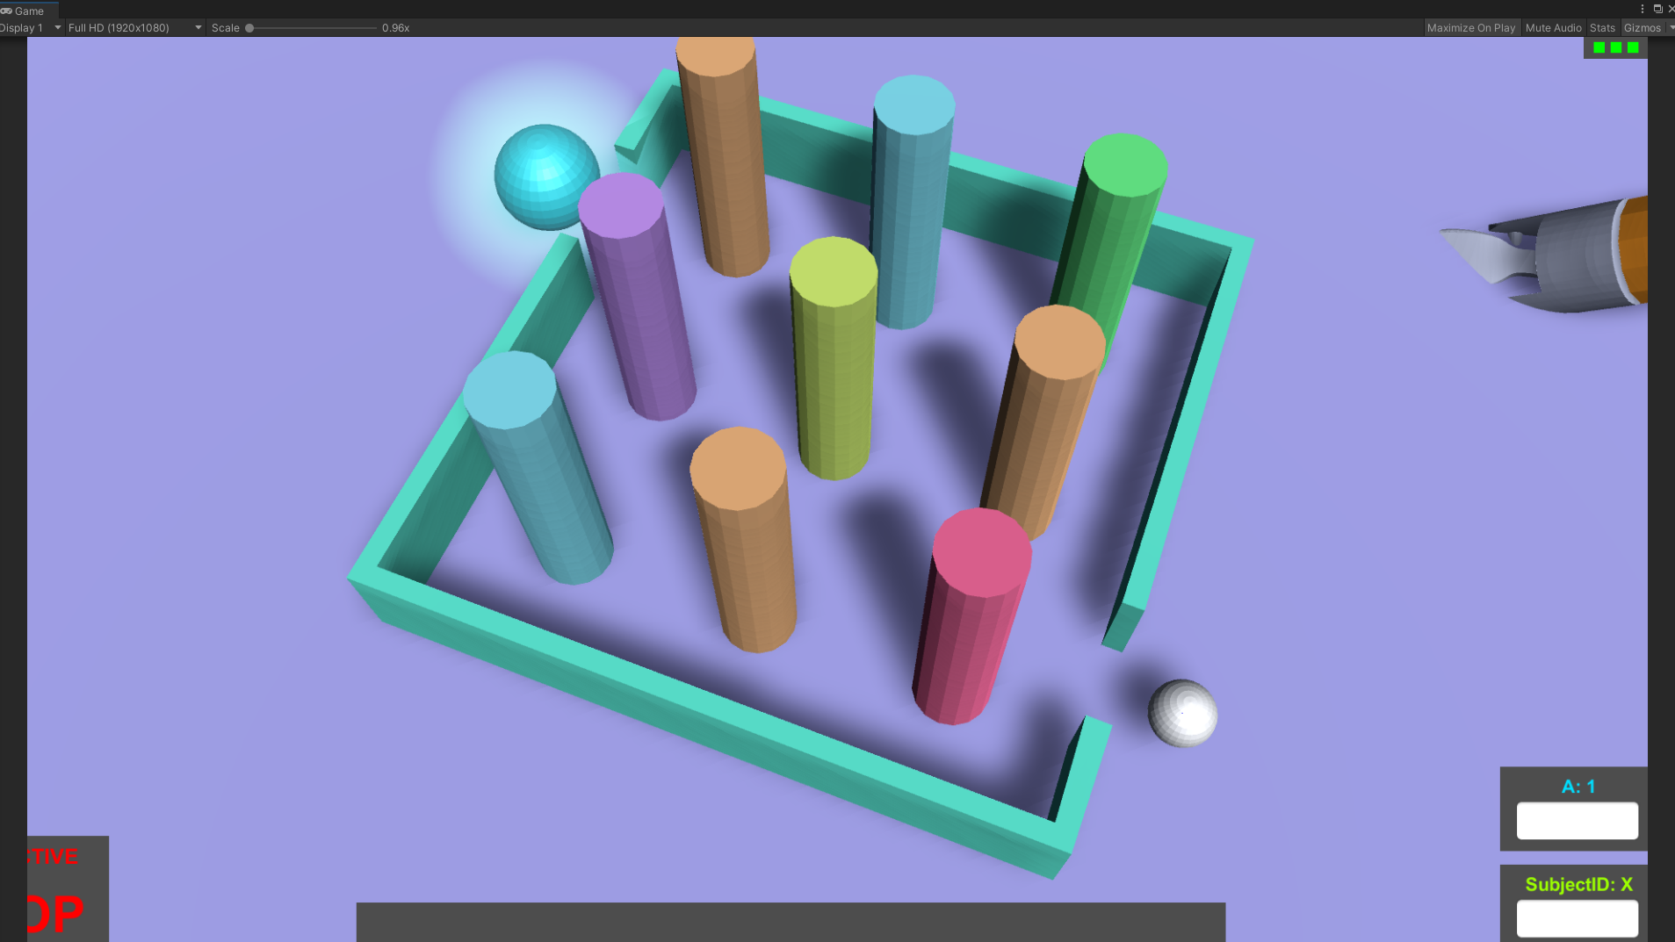
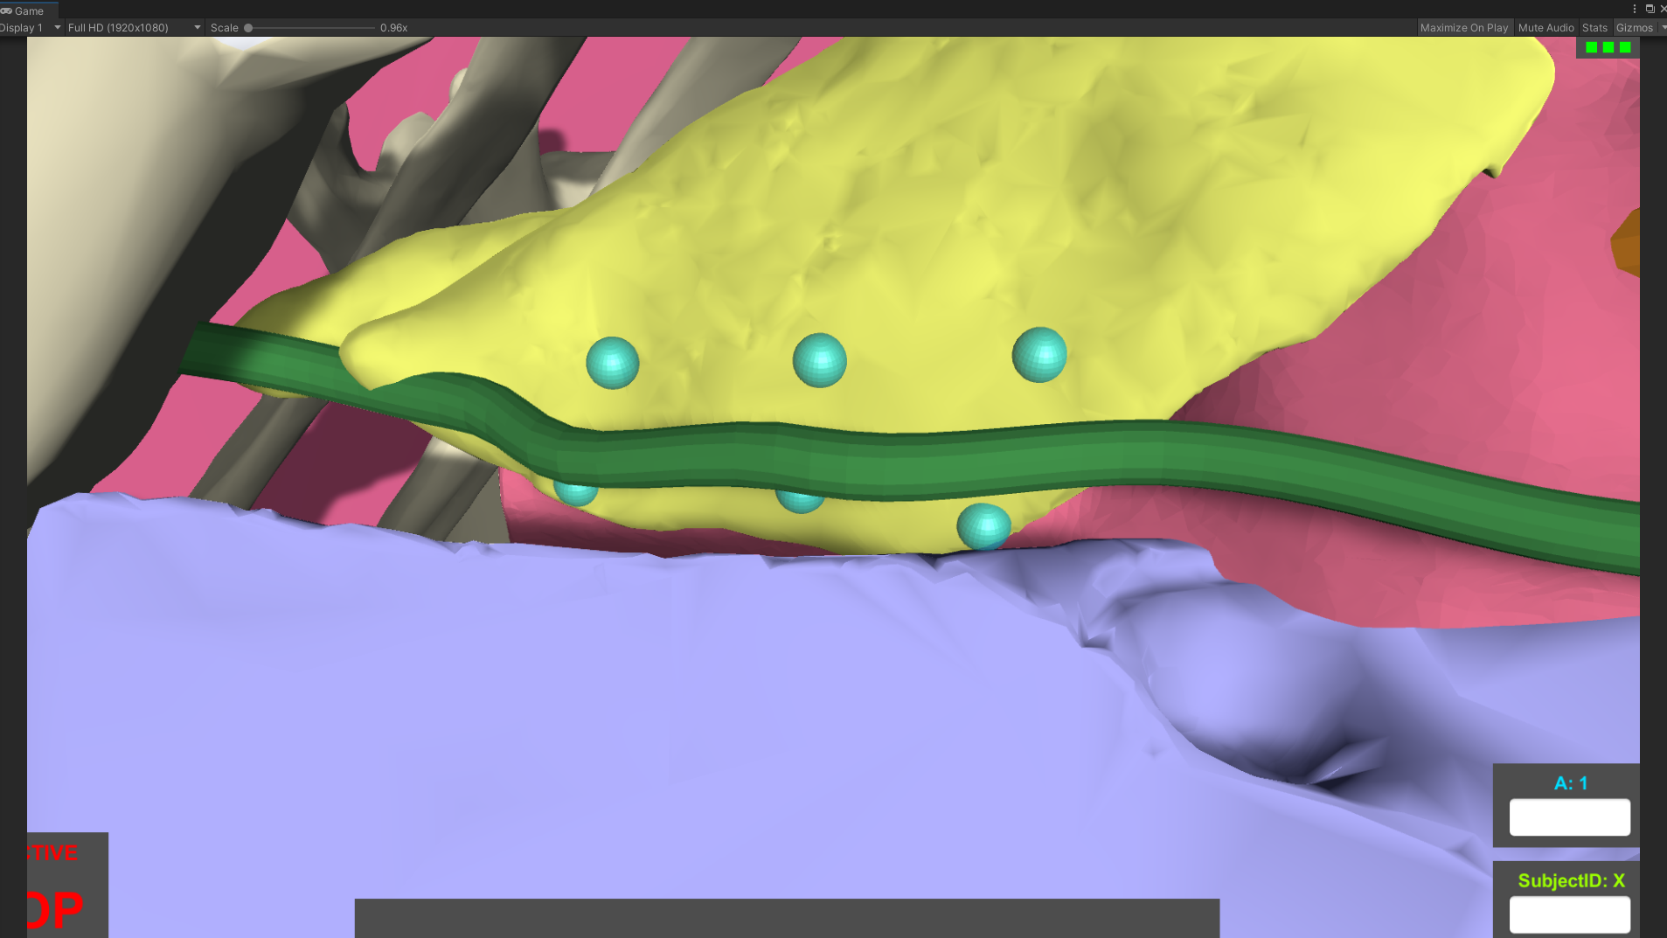
Visual Interpolation
Virtual Fixture
Obstacle avoidance
Evaluation metrics
Distance from obstacles
Time of execution
Clutch time

Slide 5
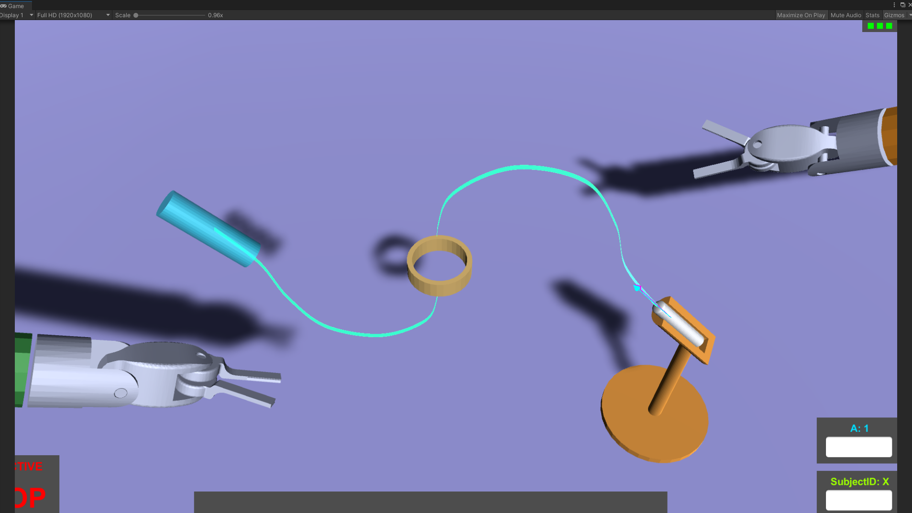
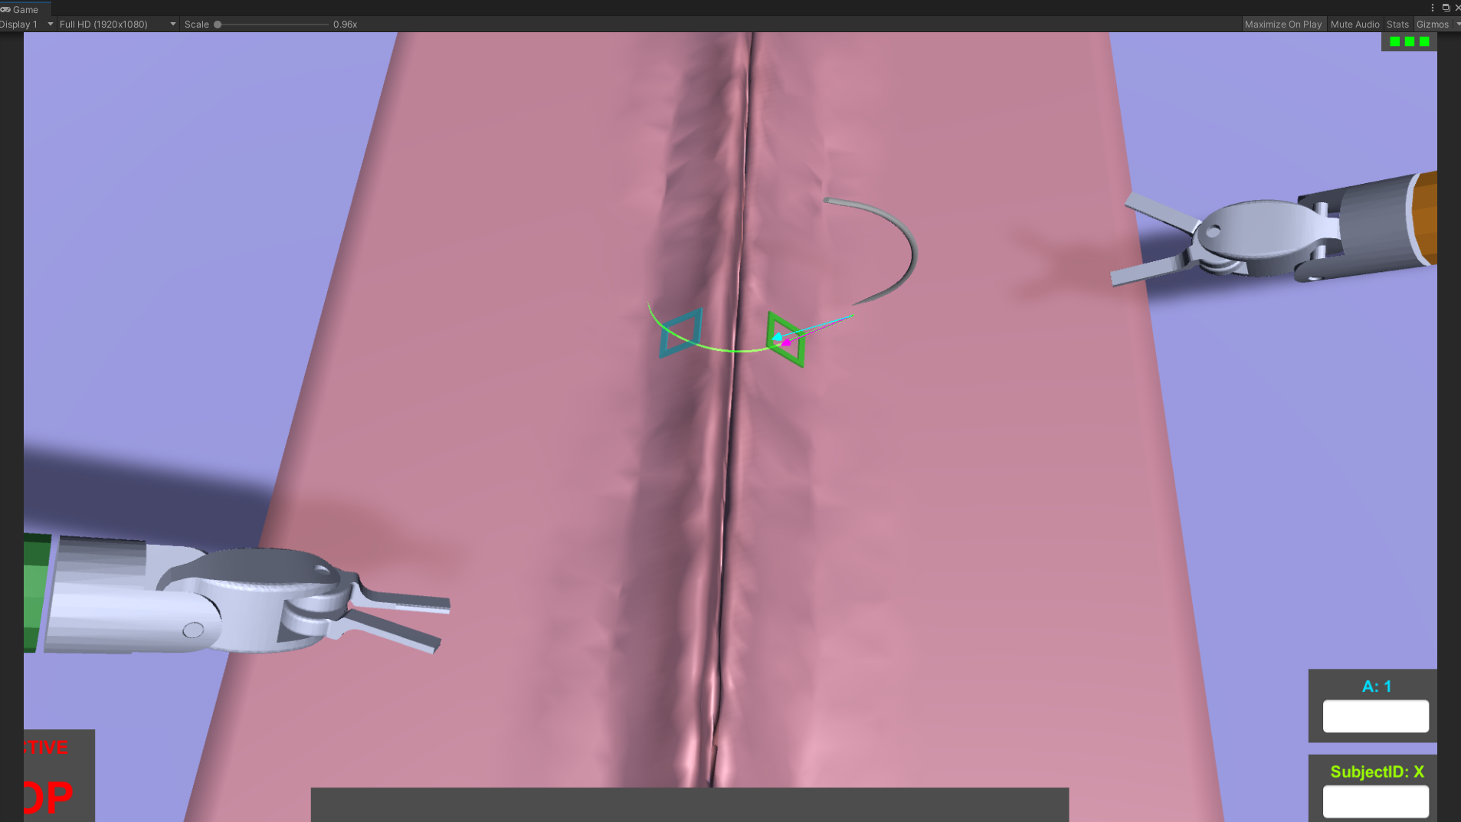
Hand-to-Hand
Virtual Fixture:
Trajectory guidance
Evaluation metrics
Distance and angle to reference trajectory
Number of drops
Time of execution
Clutch time

Slide 6
Experimental Phase
One control group C
One assisted group A
Both A and C performs a few repetitions unassisted, to assess that they belong to the same population
Group A goes on with an adaptive assistance-as-needed paradigm, C goes on unassisted
Statistical hypothesis to be verified: Increase in performance
Multi day trial?
How to set baseline performances? Record surgeon’s performance?

Slide 7


Experimental Phase: Goals
Days 1 → 5
Subjects train on the 4 training tasks
Days 6 and 7
No training
Day 8
Subject are tested on the surgical tasks (first time seen)
4 surgical training tasks, 4 tasks simulating real procedures
To demonstrate:
Better overall performance
Skill retention after 2 days break
Skill transfer from training to surgical skills

Slide 8
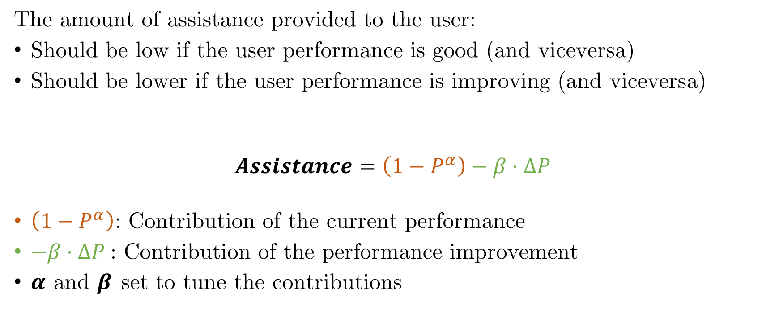
Adaptive Assistance protocol
The amount of assistance provided to the user:
Should be low if the user performance is good (and viceversa)
Should be lower if the user performance is improving (and viceversa)
$$Assistance=\left(1−P^{α}\right)−β⋅ΔP$$
$\left(1−P^{α}\right)$: Contribution of the current performance
$−β⋅ΔP$: Contribution of the performance improvement
$α$ and $β$ set to tune the contributions

Slide 9
